Slide 1

FHIR Powered Healthcare
Microsoft Health Architecture, FHIR Server, Functions, Logic Apps, Event Hubs, Service Bus, App Service, Azure AD and more…
[your hack dates]
Richard Liang
SME – Azure App Dev
Peter Laudati
SME – Azure IaaS
Gino Filicetti
SME – Azure IaaS

Slide 2
Kick Off Agenda
Welcome & Intros
How all of this will work
Kick off & squad formation
Technology overview
Hands on Challenges & team learning!
Notes:
Welcome to homeroom… where we take attendance and make all the announcements, say the pledge of allegiance, etc.

Slide 3
Objectives
What to Expect:
Overview of FHIR Server Sample reference architecture, including Azure API for FHIR, Bulk FHIR Load, SMART on FHIR, etc
Deep dive into Azure Functions, Logic Apps, Event Hubs, Service Bus and App Service
Hands on work, lab exercises to:
Extract and load FHIR patient medical records
Ingest and stream medical events for post-processing
Extract, transform and load patient clinical data
Connect to FHIR Server and read FHIR data through a JavaScript app
Explore patient medical records and encounters through FHIR Patient Dashboard and SMART on FHIR apps
Create a new Single Page App (SPA) for patient search
Intended Outcomes:
WTH participants will walk away with:
Ability to deploy and interact with FHIR Server reference architectures in Microsoft Health Architecture
Ability to write custom logic app base event-driven workflow to interact with FHIR APIs and Proxy
Ability to write web app to interact with FHIR Server through FHIR interfaces
A deeper understanding of Serverless and Event-driven architecture

Slide 4
Challenge #0 Pre-requisites – Ready, Set, GO!
Install Windows Subsystem for Linux (Bash Shell)
Install the Azure CLI (V2)
Install PowerShell Cmdlets for Azure
Install Visual Studio Code (and extensions)
Install Postman
Install .NET Core 3.1 SDK
Install Java 1.8 JDK
Download NodeJS and run executable
Install Node and NPM
Notes:
If you have a Mac… great! You’re already a step ahead.
If not, get your Windows box loaded up with all the tools that work well in the OSS world!

Slide 5
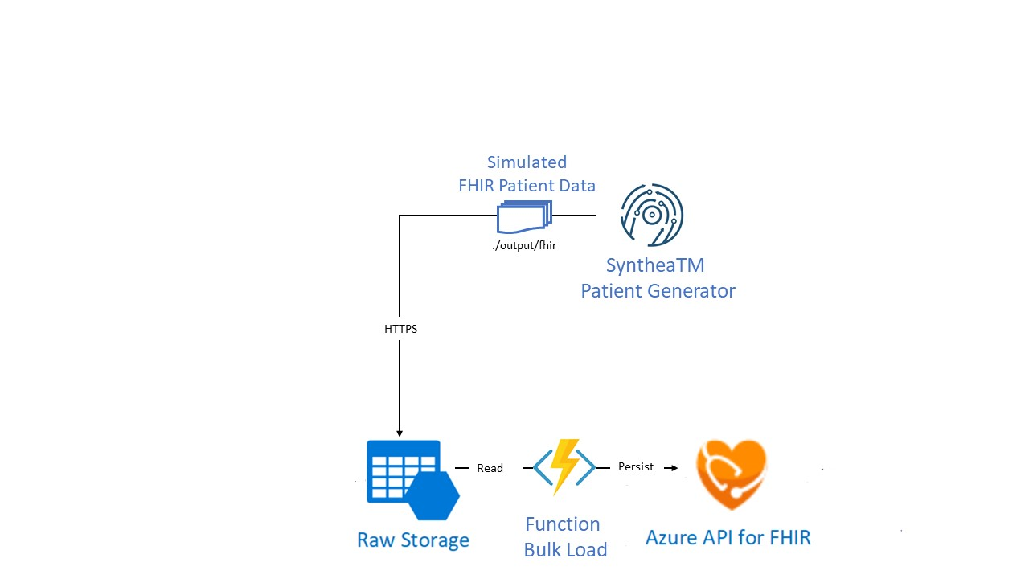
Challenge #1 Extract and load FHIR patient medical records
Deploy FHIR Server Samples reference architecture to bulk load FHIR data
Generate simulated patient data in FHIR format and load them into FHIR Server
Notes:
If you have a Mac… great! You’re already a step ahead.
If not, get your Windows box loaded up with all the tools that work well in the OSS world!

Slide 6
Enabling Healthcare Solutions in Azure

Slide 7

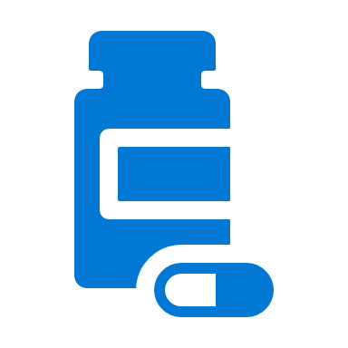




Modern Healthcare Solutions Face New Challenges
TRADITIONAL HEALTH DATA SYSTEMS
Interoperability
Security
Compliance
EVOLVING DATA SYSTEMS
Notes:
Organizations building healthcare solutions face significant challenges as the data needed for modern solutions leveraging advanced analytics and machine learning can be difficult to access and is often segregated into different silos based on a variety of healthcare systems including electronic health records (EHR), financial/billing systems, customer relationship management (CRM) for marketing, picture archiving and communication systems (PACS) for imagery and more. To further complicate matters, evolving health data systems, including connected devices in the Internet of Medical Things (IoMT), genomics and immunomics systems, big data sets from government agencies and research institutions and more, make it difficult to get a complete view of a patient’s or population’s data. The desire is to bring all this data together to build modern healthcare solutions that can improve clinical, financial, operational, and population health analytics. The ability to digitally capture, annotate, and combine data to apply machine learning will transform the delivery of healthcare.
In order to successfully bring together the relevant data and apply machine learning, organizations require a platform that supports standards-based interoperability, the security and privacy needed when working with PHI, and the compute capability to process a large amount of data.

Slide 8



Unblock healthcare innovation with health data interoperability
Based on industry standards for health data interoperability
Secure management of Protected Health Information (PHI) in a compliant cloud environment
Accelerate machine learning, data analytics, and operational outcomes with data in a normalized state
Azure API for FHIR

Slide 9

Enabling Interoperability of Health Data
INTEROPERABILITY
RESEARCH
STARTUP
Create new healthcare systems of engagement by connecting data from multiple systems of record.
Enable new research opportunities through normalized clinical data.
Focus on the innovations you are investing in instead of the data platform.
Notes:
According to the paper published in JMIR Medical Informatics “despite the relatively rapid nationwide adoption of electronic health records (EHRs), the industry’s ability to successfully exchange computable health data has not kept pace. A recent study found that less than 35% of providers report data exchange with other providers within the same organization or affiliated hospitals. The exchange of data across organizations is even more limited, with less than 14% of providers reporting they exchange data with providers in other organizations or unaffiliated hospitals.” These systems have been developed using older standards, including HL7® v2.x, Clinical Document Architecture (CDA) and proprietary APIs that make it challenging for healthcare solution developers to leverage these systems across healthcare providers. This has significantly limited access to healthcare data across providers and made it far too difficult to gain insight that can be derived from analytics and machine learning.
Azure API for FHIR® implements the HL7® FHIR® specification, enabling interoperability based on an emerging industry standard data model and RESTful interface for health data. The cloud-based API supports SMART on FHIR® integration with Azure Active Directory to enable 3rd party application developers to leverage existing application development.
The Azure API for FHIR® was designed around three primary use cases – health system interoperability, research, and startup/innovation health projects. Across these use cases is a similar pattern – data from one or more systems of record coming together in a single persistence model through the Azure API for FHIR® and being enriched through analytics and machine learning. New systems of engagement interact with the data through the Azure API for FHIR®.
Health System Interoperability
While EHRs exist as the primary ‘source of truth’ in many clinical settings, it is not uncommon for providers to have multiple instances of the same EHR offerings (10 variations of Epic installations), different EHRs in different parts of their ecosystem (5 Cerner EHR installations and 2 Epic installations) or to have several non-EHR databases that serve as a source of truth (e.g. PACs systems, research databases, IOMT databases, etc.). A typical provider ecosystem can house 20 (or more) databases that often don’t talk to one another or store data in different formats.
Standardizing on FHIR provides a more open and stable data structure and use of the Azure API for FHIR as a service that sits on top of those systems helps to enable interoperability and data exchange.
As institutions begin to implement various ML application to datasets, the Azure API for FHIR provides easy data exchange and means to annotate patient data thru FHIR APIs.
Research
Healthcare researchers will find the FHIR standard in general and the Azure API for FHIR useful as it normalizes data around a common FHIR data model and reduces the workload for machine learning and data sharing.
Exchange of data via the Azure API for FHIR provides audit logs and access controls which help control the flow of data and who has access to what data types.
Startup & Innovation Projects
Customers developing a patient or provider centric app (mobile or web) can leverage Azure API for FHIR as a fully managed backend service. The Azure API for FHIR provides a valuable resource in that customers can managing data and exchanging data in a secure cloud environment designed for health data, leverage SMART on FHIR implementation guidelines, and enable their technology to be utilized by all provider systems (e.g. most EHRs have enabled FHIR read APIs).

Slide 10
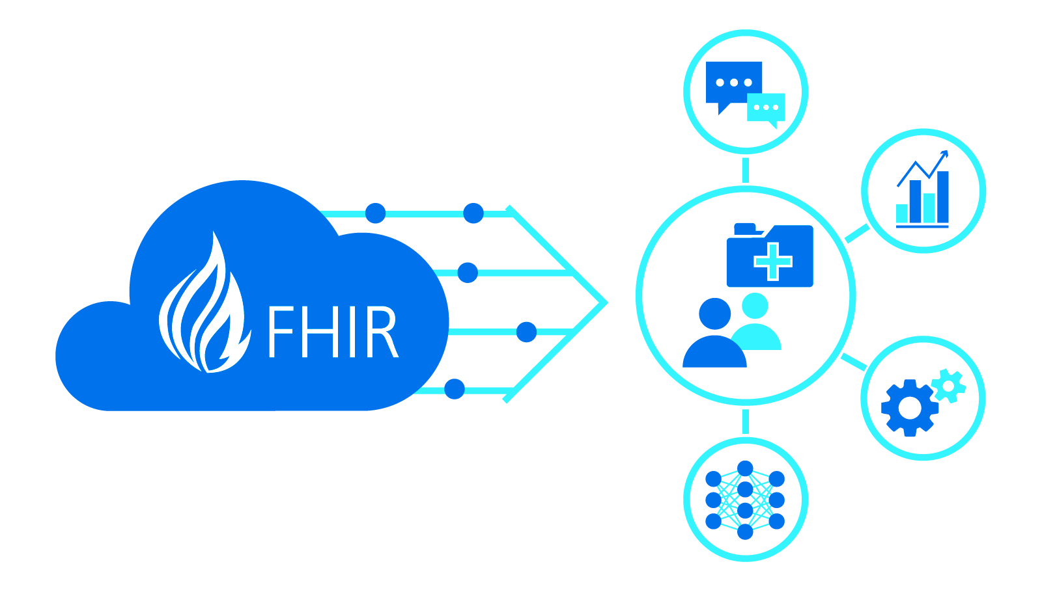
Connecting at the point of care
Health system interoperability
New systems of engagement – clinician apps, patient apps
Research and startup projects (e.g. IoMT)

Slide 11









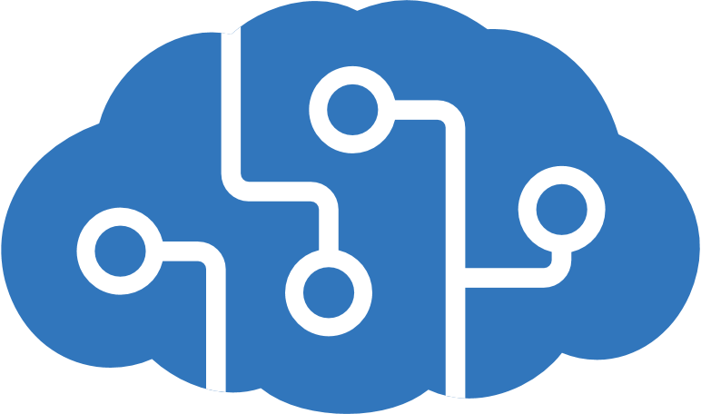


Enabling Healthcare Solutions in Azure
EHR
Imaging
-omics
Ingest & Enrich
Easily ingest and enrich any volume, variety or velocity of Healthcare data.
Persist
Create unified longitudinal records and track lineage.
Query & Provision
Provision and manage access for querying, exploration, operationalization.
Intelligence
Create new insights and build targeted AI models on the entire data estate.
3rd Party Data
IoMT
Scale
Easily leverage cloud for storage or processing of a variety of modalities at scale and lower costs.
Billing / Finance
CRM
Trust
Secure, compliant and operational.
Notes:
Who do these orgs need and want?
Initiatives: Interoperability, research, innovation
Moved to new standards defined by FHIR
Enable new tech to speak to your language 5000 feet view of what orgs are looking for
All system are generating data about patient and activities of particular org
Diff to connect and operate with one another
Put everything in one place for single view
Intelligences
Ingest systems into a single place (not replace legacy system)
Perform advanced analytics on data (AI/ML)
Scalability
Azure API for FHIR:
What we built to support what customer want
Support what customer want to do thru the above workflow:
Ingest & Enrichment of data:
- ADF – pull data out of HLC systems
- IoMT – capture real-time remote data from connected devices
Azure Functions – incorporate into some workflow
Push – system can talk directly to Azure API for FHIR
Send FHIR data directly into Azure FHIR APIs
Any system can integrate with FHIR API can integrate with Azure API for FHIR (no proprietary changes)
Persist data:
API for FHIR is where data is persisted
Customer sees the API endpoint and all security around it(not underlying infra)
Implementation details are hidden behind the scenes
Interact with those endpoints to scale up/down for throughput
Query & Provision data (into tools that are relevant):
Export FHIR data into Azure Databricks to reshape the data
Analytics and ML, need data in tabular structure and pull together diff parts of the data
Intelligence
Once data is provisioned, you can bring it into difference intelligence systems and connect that out
Azure Synapse Analytics
Machine Learning, etc.
Working outwards towards the edges:
IoMT FHIR Connector

Slide 12

Two offerings to meet your needs
Open source, full control
Built managed and maintained by the Microsoft Healthcare engineering team.
Designed to enable you to operate and manage compliance.
Fully managed Azure offering
Distribution of the open source project, offered as a Platform-as-a-Service in Azure.
Meets regulatory compliance requirements for Protected Healthcare Information (PHI).
FHIR Server for Azure
Azure API for FHIR

Slide 13

Cloud Models
Applications
Applications
Applications
Applications
You Manage
Data
Data
Data
FHIR Server for Azure
Data
Runtime
You Manage
Runtime
Runtime
Runtime
Middleware
Middleware
Middleware
Azure API for FHIR
Middleware
You Manage
O/S
O/S
O/S
Cloud Provider Manages
O/S
Virtualization
Virtualization
Cloud Provider Manages
Virtualization
Virtualization
Servers
Servers
Servers
Servers
Cloud Provider Manages
Storage
Storage
Storage
Storage
Networking
Networking
Networking
Networking
On premises
Infrastructure
(as a Service)
Platform
(as a Service)
Software
(as a Service)
Notes:
<ANNIMATED>
The Healthcare API for FHIR moves the burden of operation, maintenance, updates and compliance from the customer to Microsoft.
The Microsoft Healthcare APIs for fully managed Platform-as-a-Service offerings available in Azure (i.e. resources in the Azure Portal).

Slide 14

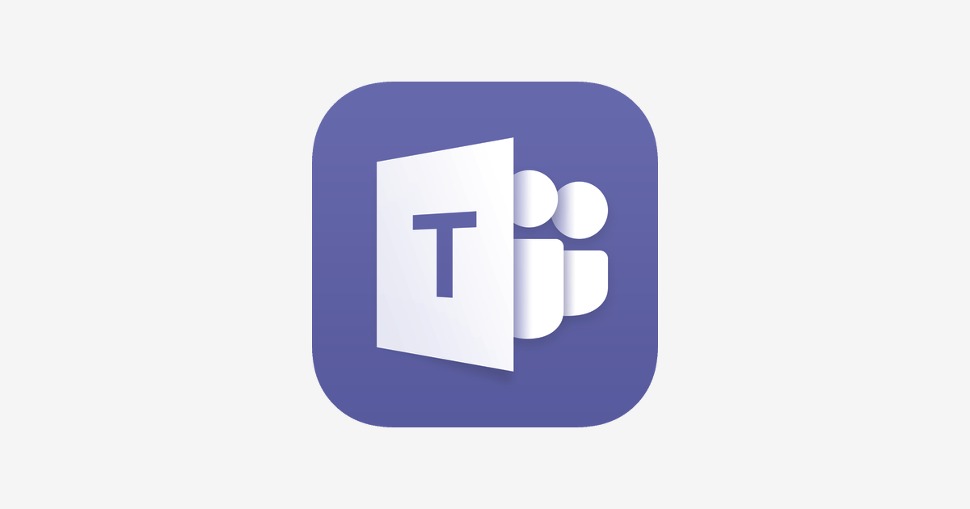








AZURE API for FHIR Example Use Case
DATA FLOW:
GENERATE
INGEST
PERSIST
ENRICH
PRESENT
FHIR
Azure API for FHIR
FHIR v3.0.1 (STU3)
FHIR v4.0.0 (R4)
Integration of multiple data sources.
Standard FHIR APIs – CRUD / Search
FHIR
Clinical Data
Patients, Procedures, Observations
Data Adaptation
Direct FHIR
HL7v2.x → FHIR
CCDA → FHIR
CSV → FHIR
Text → FHIR
Analytics & AI
FHIR
HL7v2
CCDA
CSV
Text
Insight
HDInsight
SQLDW
Azure Data Lake
-omics
Genomics, Immunomics
SYSTEMS OF RECORD
Normalize
Terminology Services (e.g. ICD-10, SNOMED CT, LOINC, RxNorm)
SYSTEMS OF ENGAGEMENT
FHIR
FHIR
Devices
IoMT, Wearables, Monitors
Intelligence
Machine Learning
Cognitive Services
Patient / Clinician Portals
Annotate
Validation (e.g. Profiles)
Labelling (e.g. Mental Health data)
3rd Party Data
Demographic, Geographic, Psychographic
FHIR
Mobile Experiences
Other Data
CRM, Billing, Marketing
Identity, Security & Audit
Identity management, audit logs, role-based access control
Dashboards

Slide 15
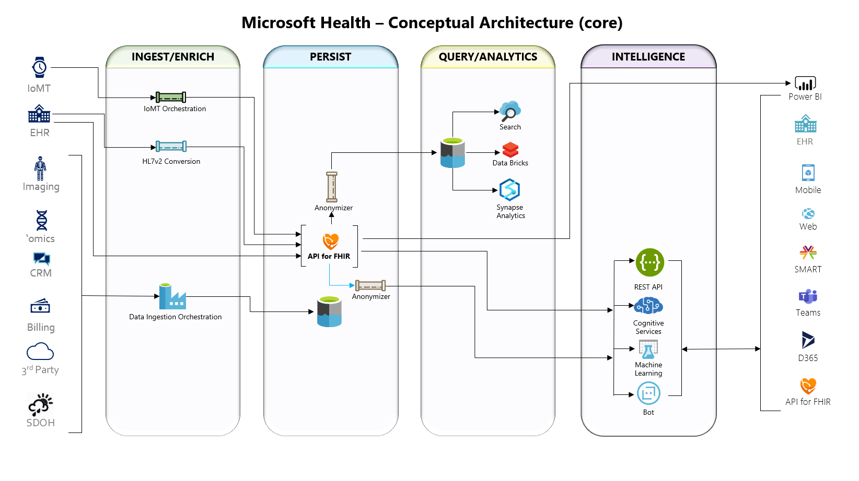
Notes:
FhirDashboard URL: https://fhirsampdevdash.azurewebsites.net (.NET WebApp) or https://fhirsampdevjs.azurewebsites.net/ (JavaScript SPA app) User: fhirsampdev-admin@fhirserversamples.onmicrosoft.com Password: Fh1rD3m0!!

Slide 16
FHIR Bulk Import
Function app imports FHIR data whenever new BLOB is added to ‘fhirimport’ container
A storage account with a BLOB container called ‘fhirimport’ is deployed
Copy FHIR data into this storage container
A function app will automatically ingest them into FHIR Server whenever a BLOB is added to this container
https://github.com/microsoft/fhir-server-samples/tree/master/src/FhirImporter
Notes:
FHIR spec defines a Bulk Export API
Now support bulk export of FHIR service
Export entire content of Azure API for FHIR into JSON docs into a storage container and pick up in Databrick
Working on filtering of data, i.e. only male patients
For secondary use, but need to first de-identify data
Research
Analytics

Slide 17
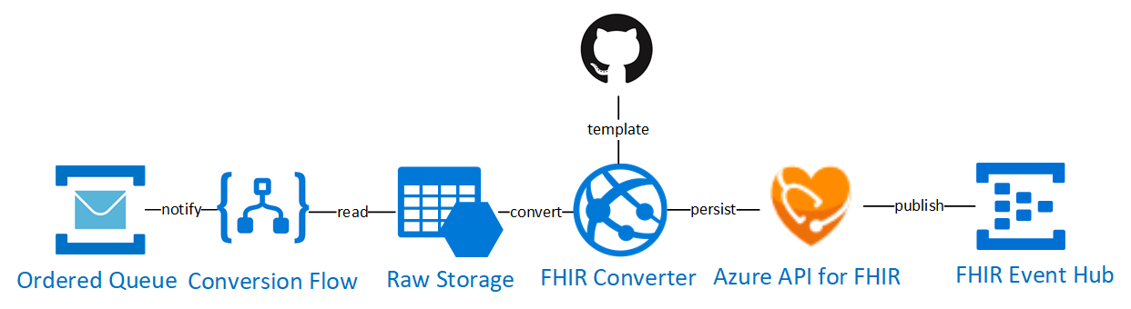
Challenge #2 Ingest and stream medical events for post-processing
Deploy HL7 Ingest platform in Microsoft Health reference architecture
Deploy HL7toFHIR Conversion Workflow in Microsoft Health reference architecture
FHIR Event Processor to publish medical events to event hub
Logic App workflow to convert and load C-CDA to FHIR Bundles to FHIR Server
Notes:
If you have a Mac… great! You’re already a step ahead.
If not, get your Windows box loaded up with all the tools that work well in the OSS world!

Slide 18
Azure FHIR Converter
Enables conversion of legacy formatted health data into FHIR bundle
Transforms HL7 v2 messages and CDA documents into FHIR bundles.
Mapping template defines conversion between HL7 v2 or C-CDA data format to FHIR bundle
FHIR bundle returned for further data manipulation
FHIR bundle returned persisted into a FHIR server, such as the Azure API for FHIR
https://github.com/microsoft/fhir-converter
Notes:
Azure FHIR Converter Ingestion capability
Resistance – not all data is in FHIR, still has HL7 v2 data
Open source in github based on what’s done by existing working group
Template driven system
Bring HL7 v2 messages - push into an API and outputs a FHIR bundl, i.e. patient observation
Use case:
Admitted patient discharge/transfer message > pass that into FHIR converter and get a bundle of patient, encounter and observation related to them
Can modify the FHIR bundle and push it into Azure API for FHIR
This will be moved in Azure API for FHIR later this year
Conversion API will be available

Slide 19
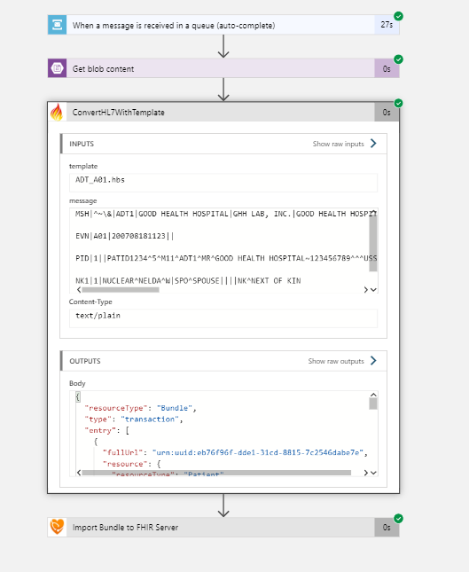
Logic App based workflow to perform HL7v2 message conversion to FHIR Bundle

Slide 20
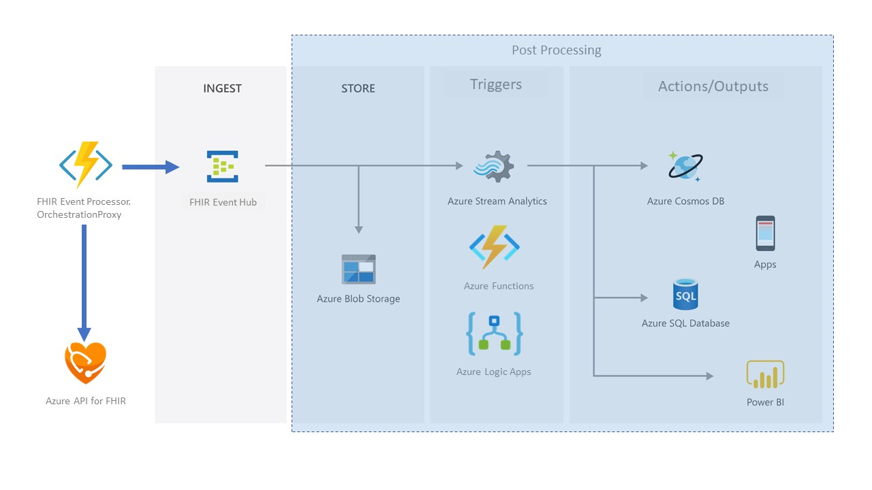
FHIR Event Processor to publish HL7 medical events for Post Processing

Slide 21
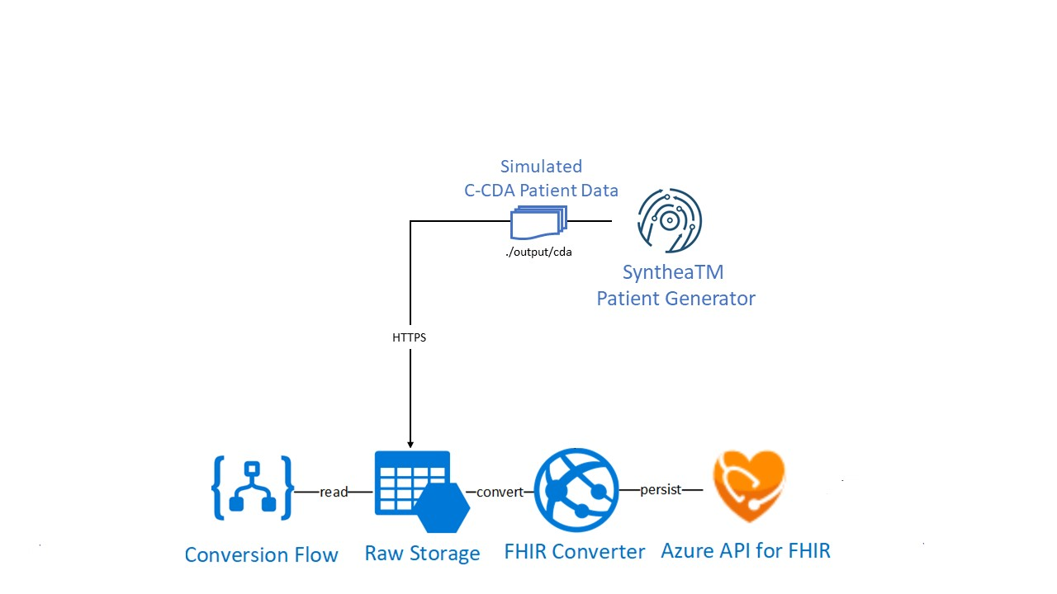
Challenge #3 Extract, transform and load patient clinical data
Use HL7toFHIR Conversion pipeline infrastructure in Health Architectures
Add a new Logic App based workflow to perform the C-CDA-to-FHIR conversion
Generate simulated patient data in C-CDA format using SyntheaTM Patient Generator
Ingest and load converted clinical data in FHIR Bundles
Notes:
If you have a Mac… great! You’re already a step ahead.
If not, get your Windows box loaded up with all the tools that work well in the OSS world!

Slide 22
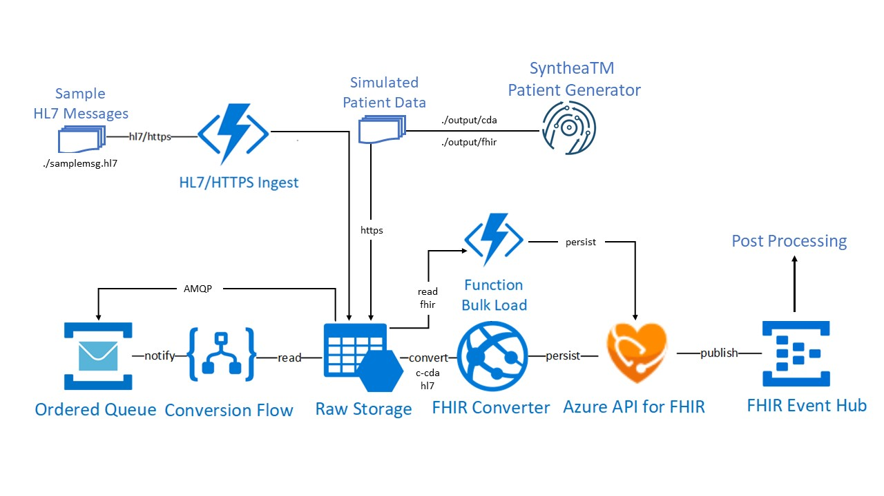
Putting it all together…

Slide 23
Challenge #4 Connect to FHIR Server and Read FHIR Data through a JavaScript App
Create a new Azure Web App to host JavaScript app
Register a public client app in Azure AD to enable JavaScript app to access FHIR Server
Write a JavaScript app to connect and read FHIR patient data
Notes:
If you have a Mac… great! You’re already a step ahead.
If not, get your Windows box loaded up with all the tools that work well in the OSS world!

Slide 24
Challenge #5 Explore patient medical records through FHIR Patient Dashboard and SMART on FHIR apps
Open FHIR Dashboard app to explore:
View a list of patients in FHIR Server
Explore patient medical elements
Conditions
Encounters
Observations
View Patient’s FHIR Bundle details
Explore SMART on FHIR Apps
Growth Chart
Medications
Notes:
If you have a Mac… great! You’re already a step ahead.
If not, get your Windows box loaded up with all the tools that work well in the OSS world!

Slide 25
Health Data Interop Enabled by FHIR
Patient
Fast Healthcare Interoperability Resources (FHIR) is the health industry data standard describing:
Data formats and elements (known as "resources").
Application Programming Interface (API) for exchanging the resources.
Uses a modern web-based suite of technology, including an HTTP-based RESTful protocol, and JSON.
DiagnosticReport
SUBJECT
Condition
REPORT
RELATED
Procedure
ENCOUNTER
Encounter
PERFORMER
Practitioner
Notes:
Fast Healthcare Interoperability Resources (FHIR, pronounced "fire") is a draft standard describing data formats and elements (known as "resources") and an application programming interface (API) for exchanging electronic health records. The standard was created by the Health Level Seven International (HL7) health-care standards organization.
FHIR builds on previous data format standards from HL7, like HL7 version 2.x and HL7 version 3.x. But it is easier to implement because it uses a modern web-based suite of API technology, including a HTTP-based RESTful protocol, HTML and Cascading Style Sheets for user interface integration, a choice of JSON, XML or RDF for data representation, and Atom for results. One of its goals is to facilitate interoperation between legacy health care systems, to make it easy to provide health care information to health care providers and individuals on a wide variety of devices from computers to tablets to cell phones, and to allow third-party application developers to provide medical applications which can be easily integrated into existing systems.
FHIR provides an alternative to document-centric approaches by directly exposing discrete data elements as services. For example, basic elements of healthcare like patients, admissions, diagnostic reports and medications can each be retrieved and manipulated via their own resource URLs.
Because FHIR is implemented on top of HL7 and the HTTPS (HTTP Secure) protocol, messages can be parsed by wire data analytics platforms for real-time data gathering. In this concept, healthcare organizations would be able to gather real-time data from specified segments in FHIR messages as those messages pass over the network. That data can be streamed to a data store where it can be correlated with other informatics data. Potential use cases include epidemic tracking, prescription drug fraud, adverse drug interaction warnings, and emergency room wait times.

Slide 26
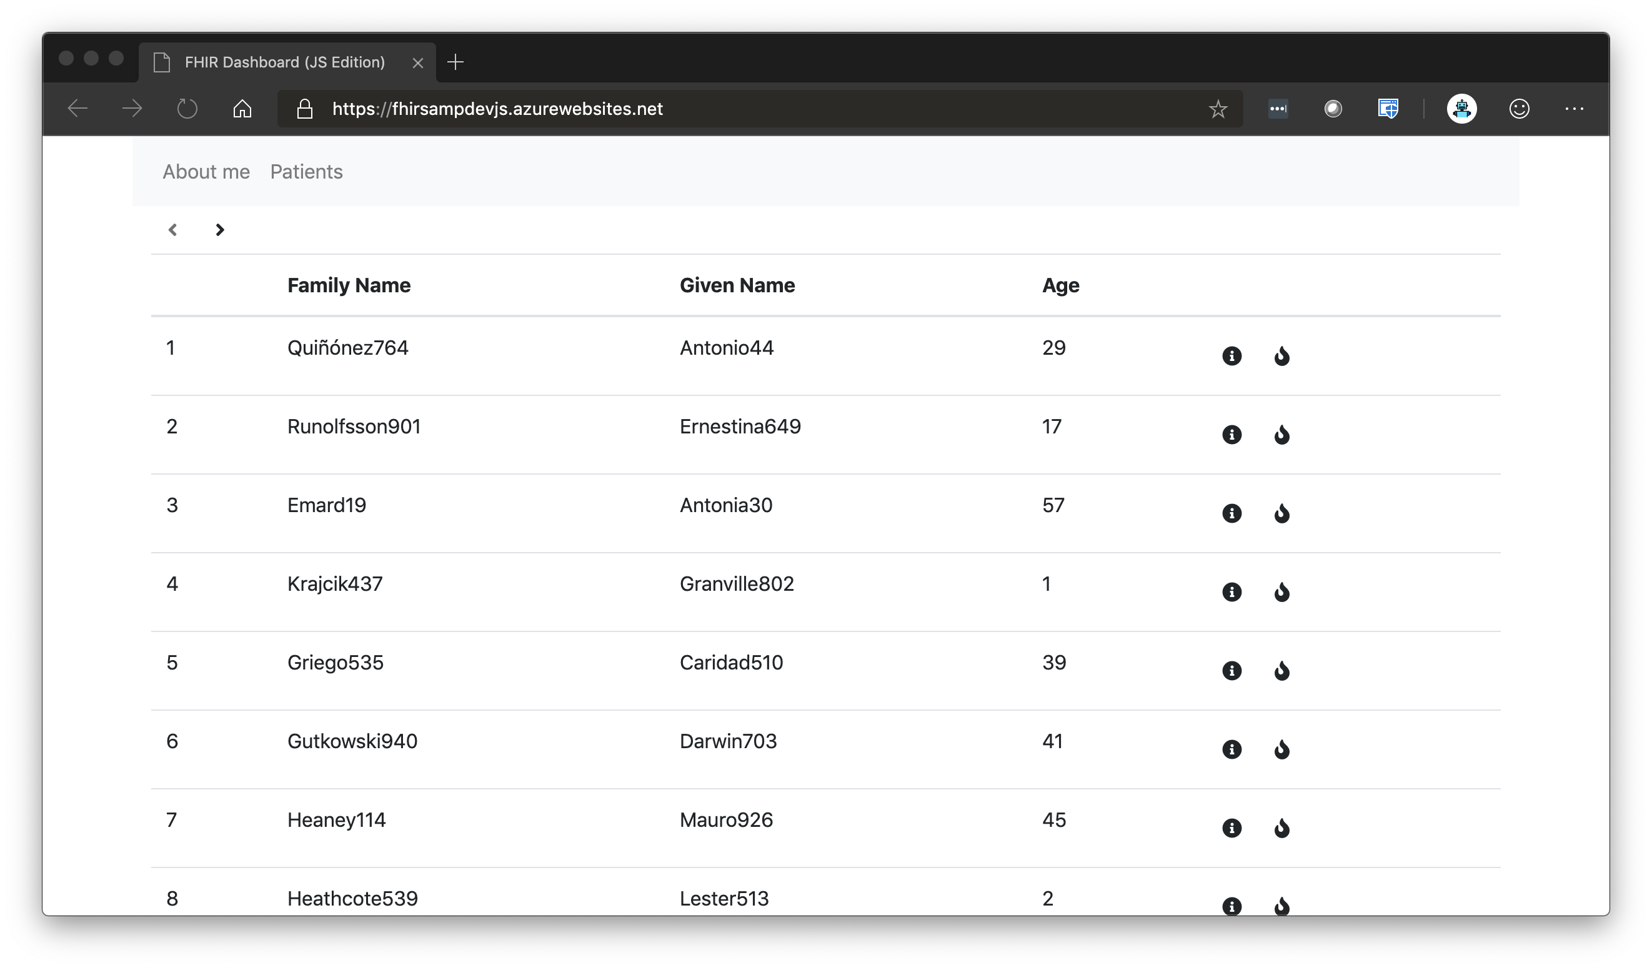

Slide 27
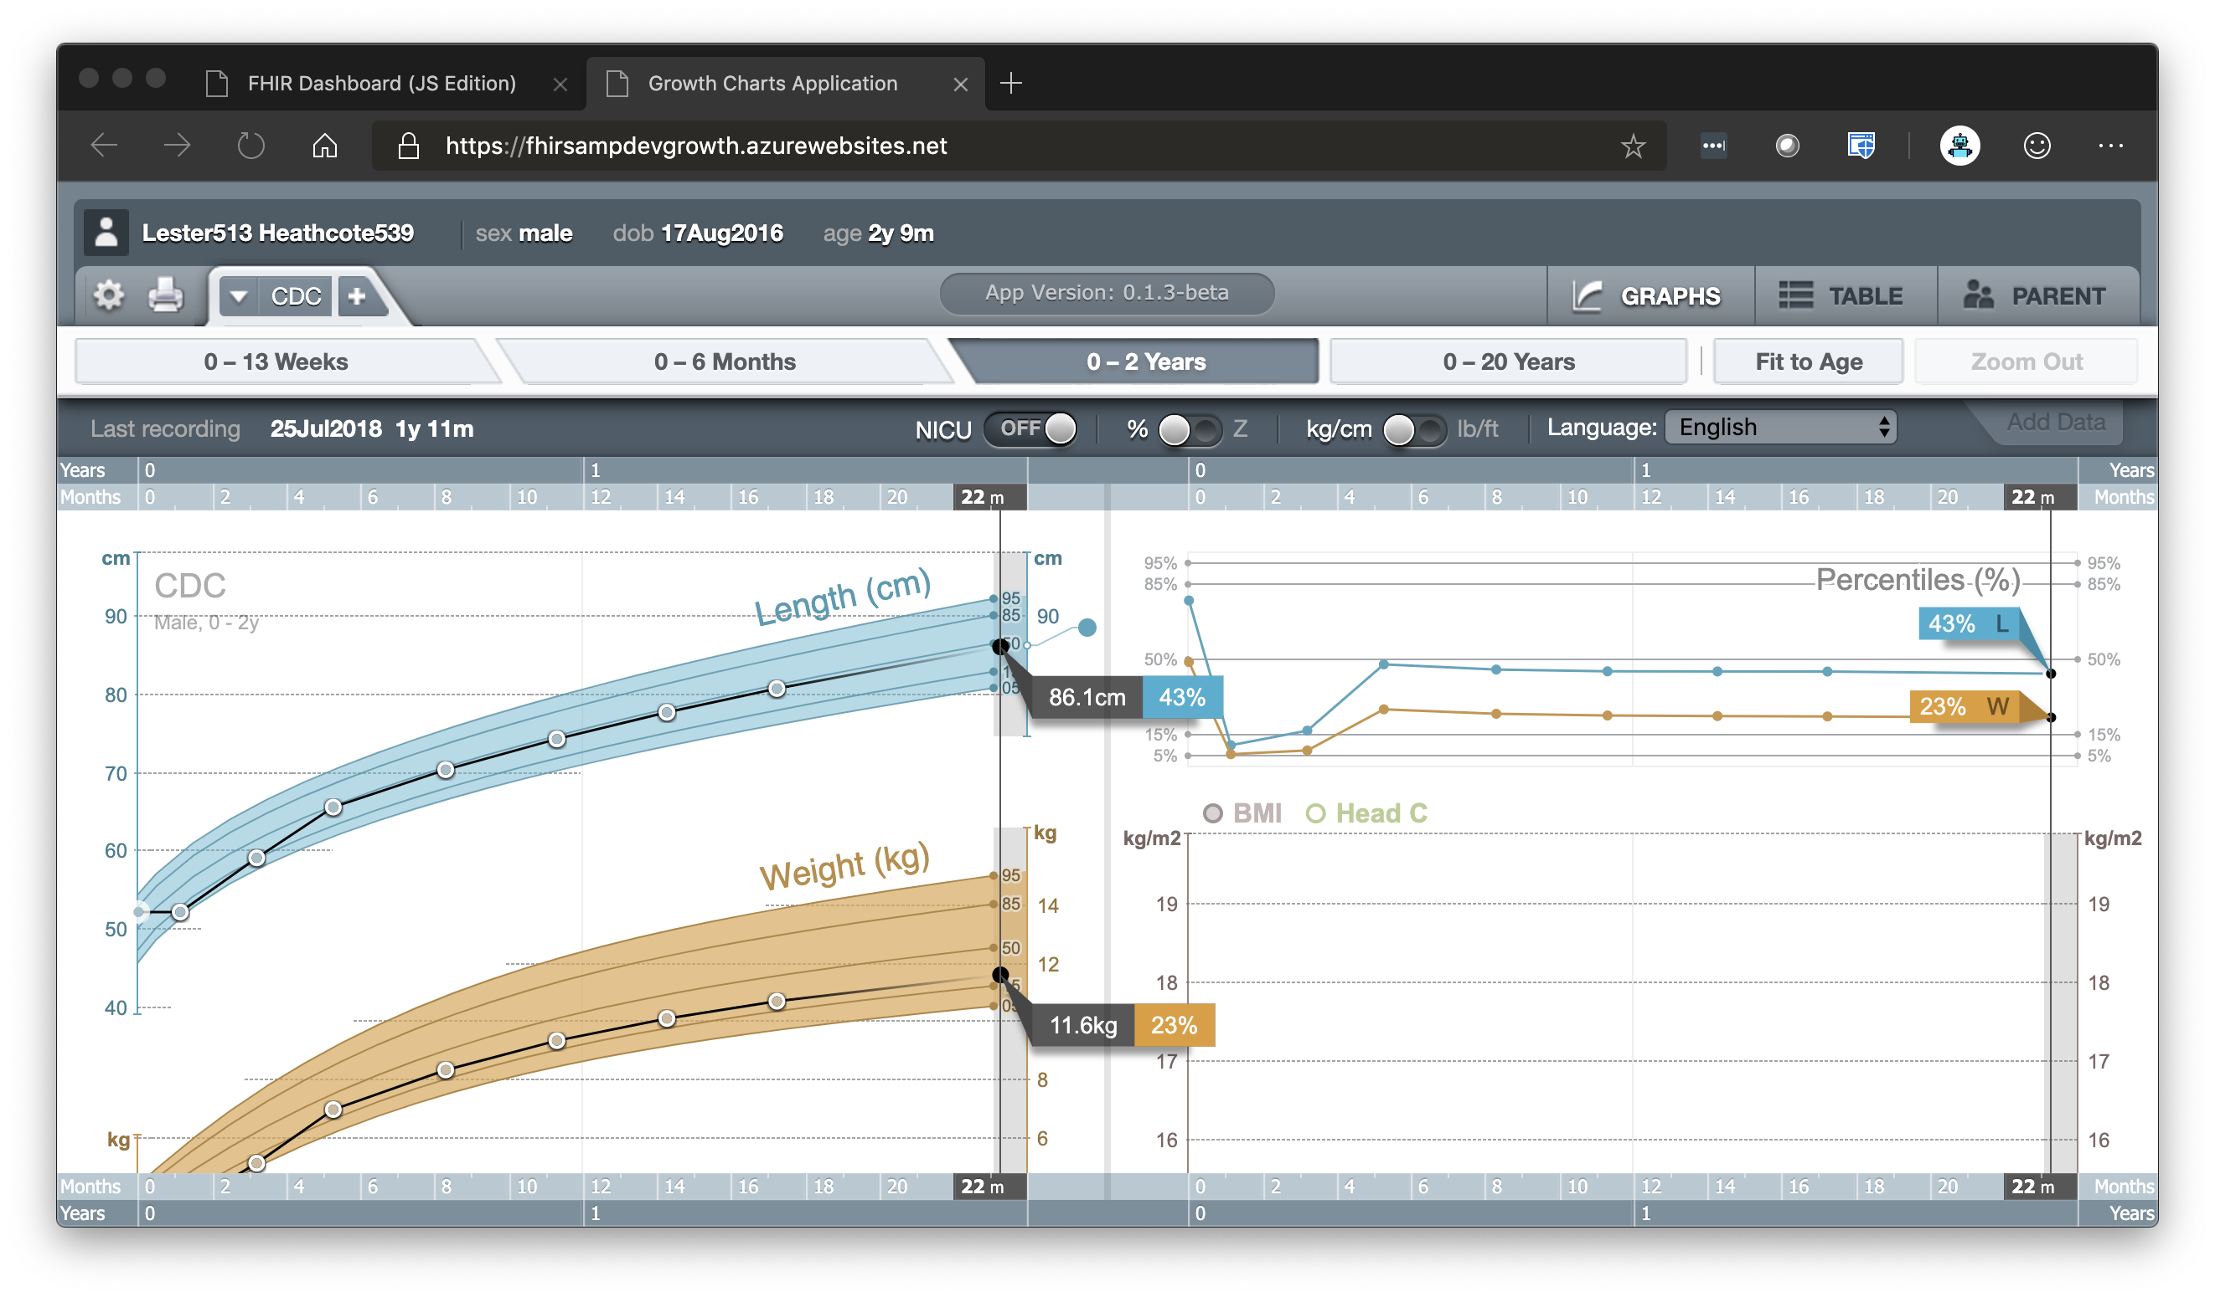

Slide 28
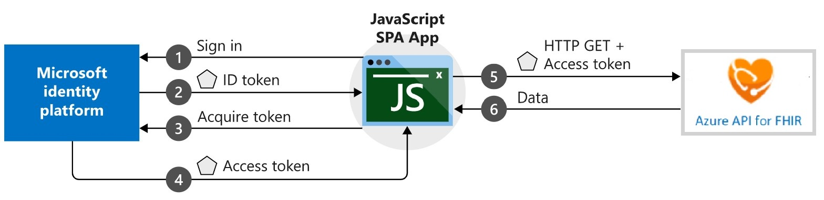
Challenge #6 Create a new Single Page App (SPA) for patient search
Create a new JavaScript SPA app
Integrate and configure the Microsoft Authentication Library (MSAL) with yourJavaScript SPA app to fetch data from protected FHIR web API.
Create a patient lookup by Given or Family name in JavaScript SPA app.
Build and run JavaScript SPA app (local and Azure)
Register Patient Search app website URI in App Registration (local and Azure)
Test Patient Lookup in Patient Search app website
Notes:
If you have a Mac… great! You’re already a step ahead.
If not, get your Windows box loaded up with all the tools that work well in the OSS world!

Slide 29
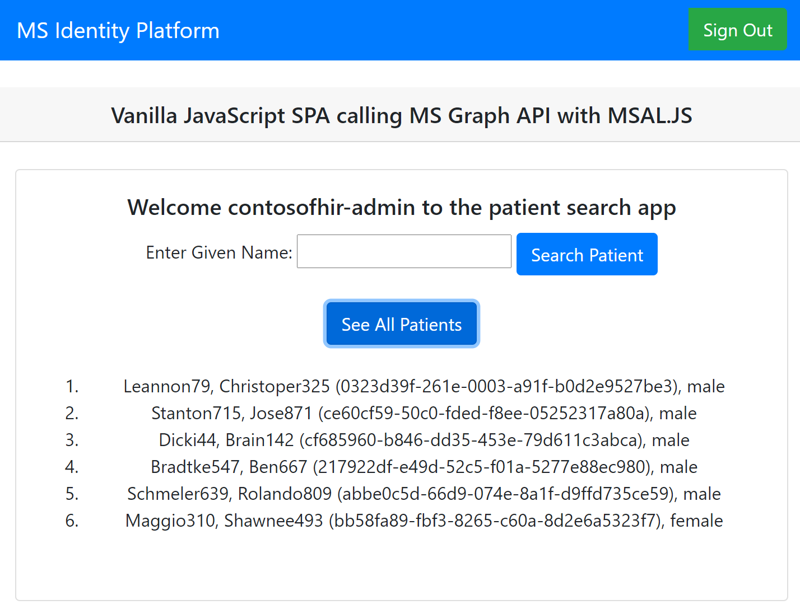
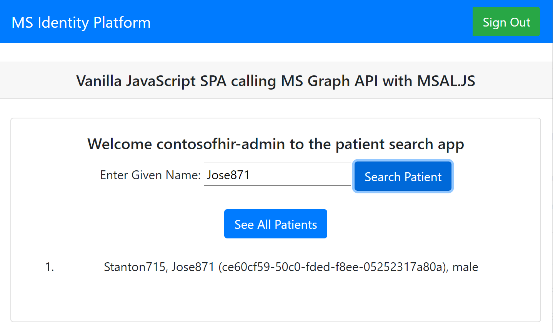
Challenge #6 Create a new Single Page App (SPA) for patient search
Notes:
If you have a Mac… great! You’re already a step ahead.
If not, get your Windows box loaded up with all the tools that work well in the OSS world!

Slide 30
Thank you

